Slide 1
A Better GIL for Python 2.7
- Samrat Revagade

Slide 2
Python GIL
GIL : You do not talk about it…
Parallel execution is forbidden
There is a "global interpreter lock"
The GIL ensures that only one thread runs in the interpreter at once
Lets c how it works – intro demo.

Slide 3
GIL with multithreaded program – Vanilla Python
Check
100 ticks
100 ticks
100 ticks
Thread -1
READY
Context switch
Pthread OS
Running…
Thread - 2
READY

Slide 4
GIL with multithreaded program - Hacked GIL
Running…
Thread -1
WAIT
Suspended
signal
Gil_drop_request =1
Gil_drop_request =0
timeout
Running…
Thread - 2
Suspended
WAIT

Slide 5
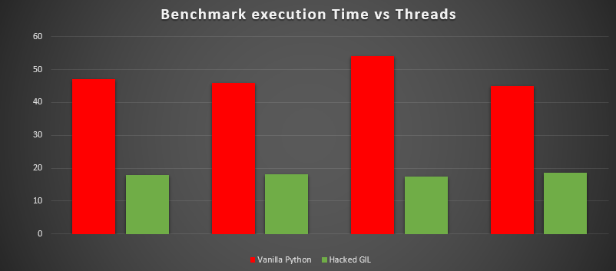
Seconds
2 4 8 16
threads …

Slide 6
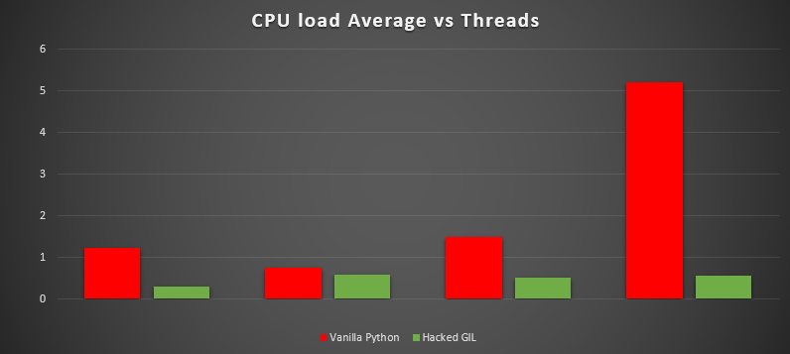
Load avg.
2 4 8 16
threads …

Slide 7
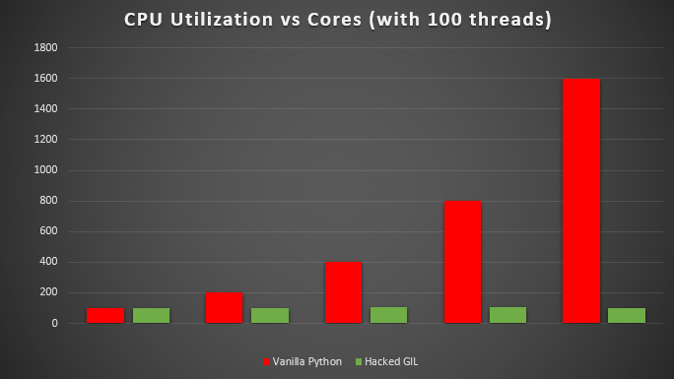
Utilization
CPU Utilization vs CPU cores
CPU cores
1 2 4 8 16

